Slide 1
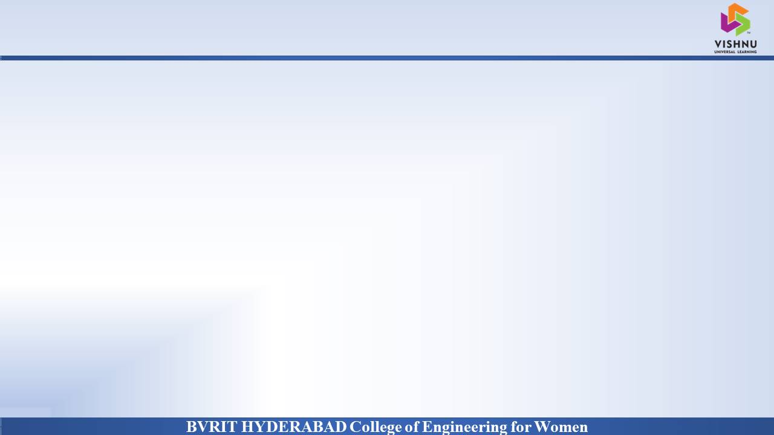
Department of Computer Science and Engineering
Diabetic Retinopathy Detection
Date: 28 May 2021
Vunnam Neha Chowdary : 17wh1a0594
Jangampally Nikitha : 17wh1a05a1
Surannagari Shirisha : 18wh5a0518
Internal Guide: Mr. M Dyva Sugnana Rao
Designation : Assistant Professor

Slide 2

Abstract
Why Should I Study this course?
Diabetic retinopathy (DR) is an eye disease caused by the complication of diabetes and we should detect it early for effective treatment. As diabetes progresses, the vision of a patient may start to deteriorate and lead to diabetic retinopathy. First we pre-process the image to enhance the required features for the ML techniques to work. Next, we extract features using Gabor filters and feed into our ML algorithms.
Examples
BVRIT HYDERABAD College of Engineering for Women

Slide 3
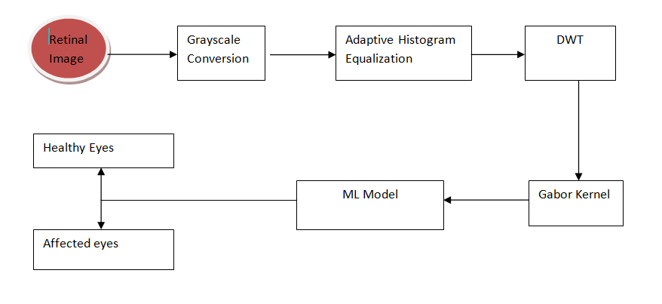
Block Diagram
Why Should I Study this course?
Examples
Fig. 1. Block Diagram of Proposed System
BVRIT HYDERABAD College of Engineering for Women

Slide 4
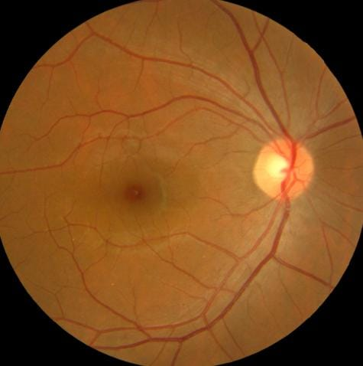
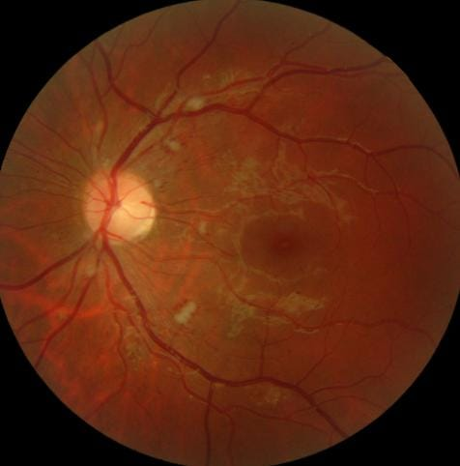
Sample Images
Fig. 3. Healthy Retinal Fundus Fig. 4. Retinal Fundus with DR

Slide 5
Output
Why Should I Study this course?
Examples
Classifier | Accuracy
SVM | 96.6%
KNN | 94.3%
RF | 96%
MLP | 94%
BVRIT HYDERABAD College of Engineering for Women

Slide 6
Thankyou

